Slide 1


Peacoq jitter correction
Presented by Andrew Mueller
8/16/2021

Slide 2
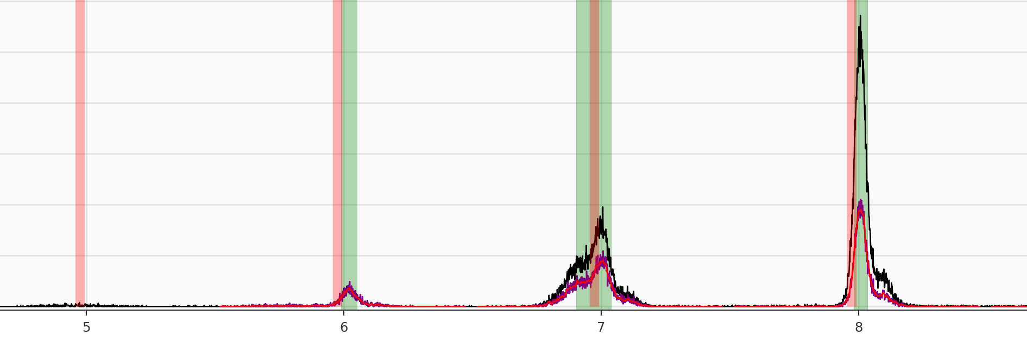
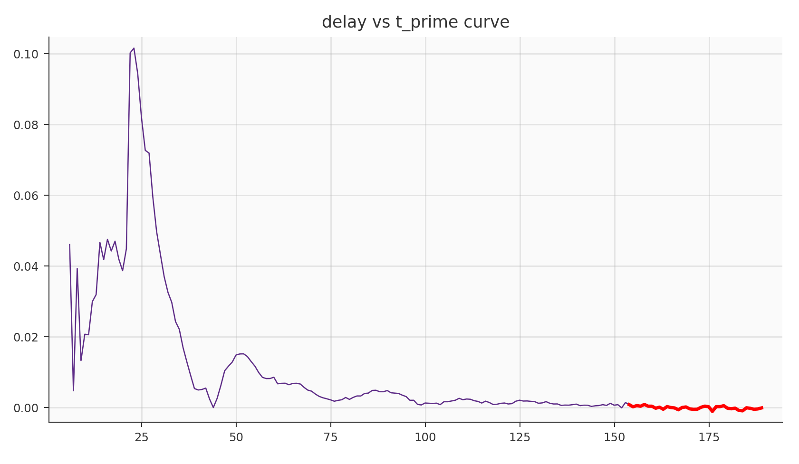


Now based on 1 GHz data set
Good balance between resolution and separability compared with 4 GHz and 500 MHz datasets.
Collected extensive data for Wire 1 and Wire 16
Range of attenuations, each for different trigger levels and different bias currents
Jitterate correction still works to cancel out amplifier reflection effects

Slide 3
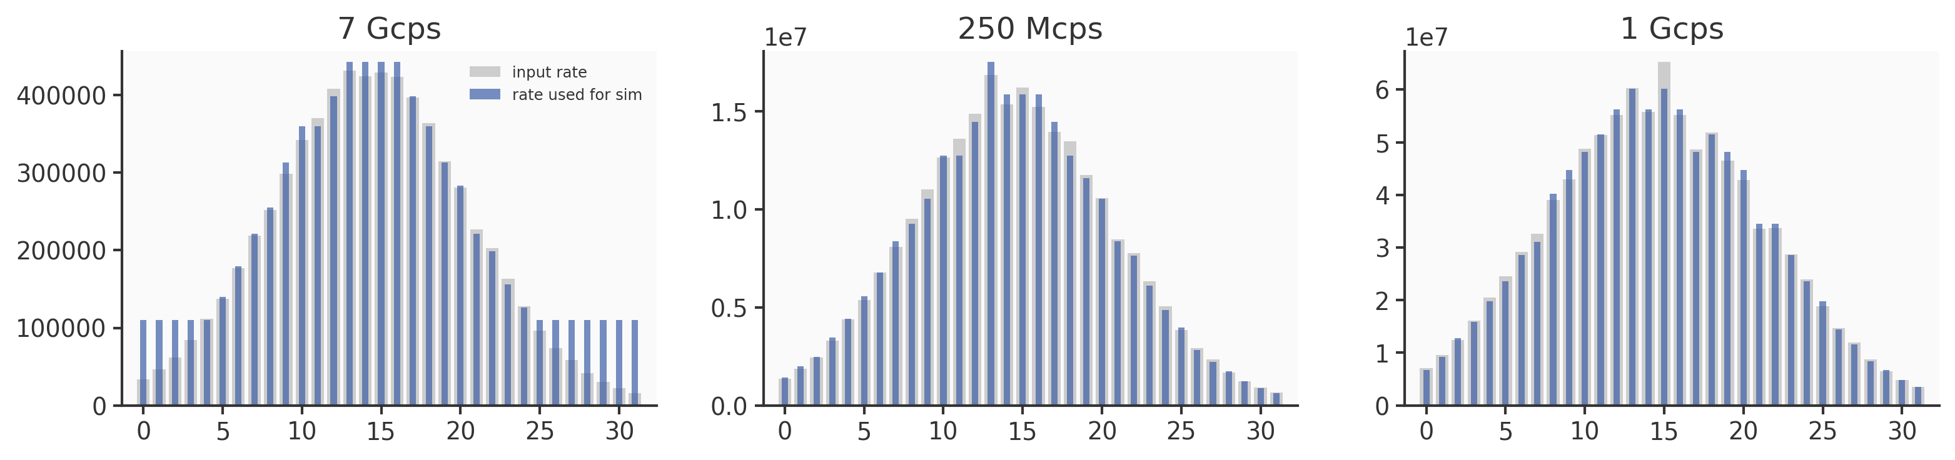
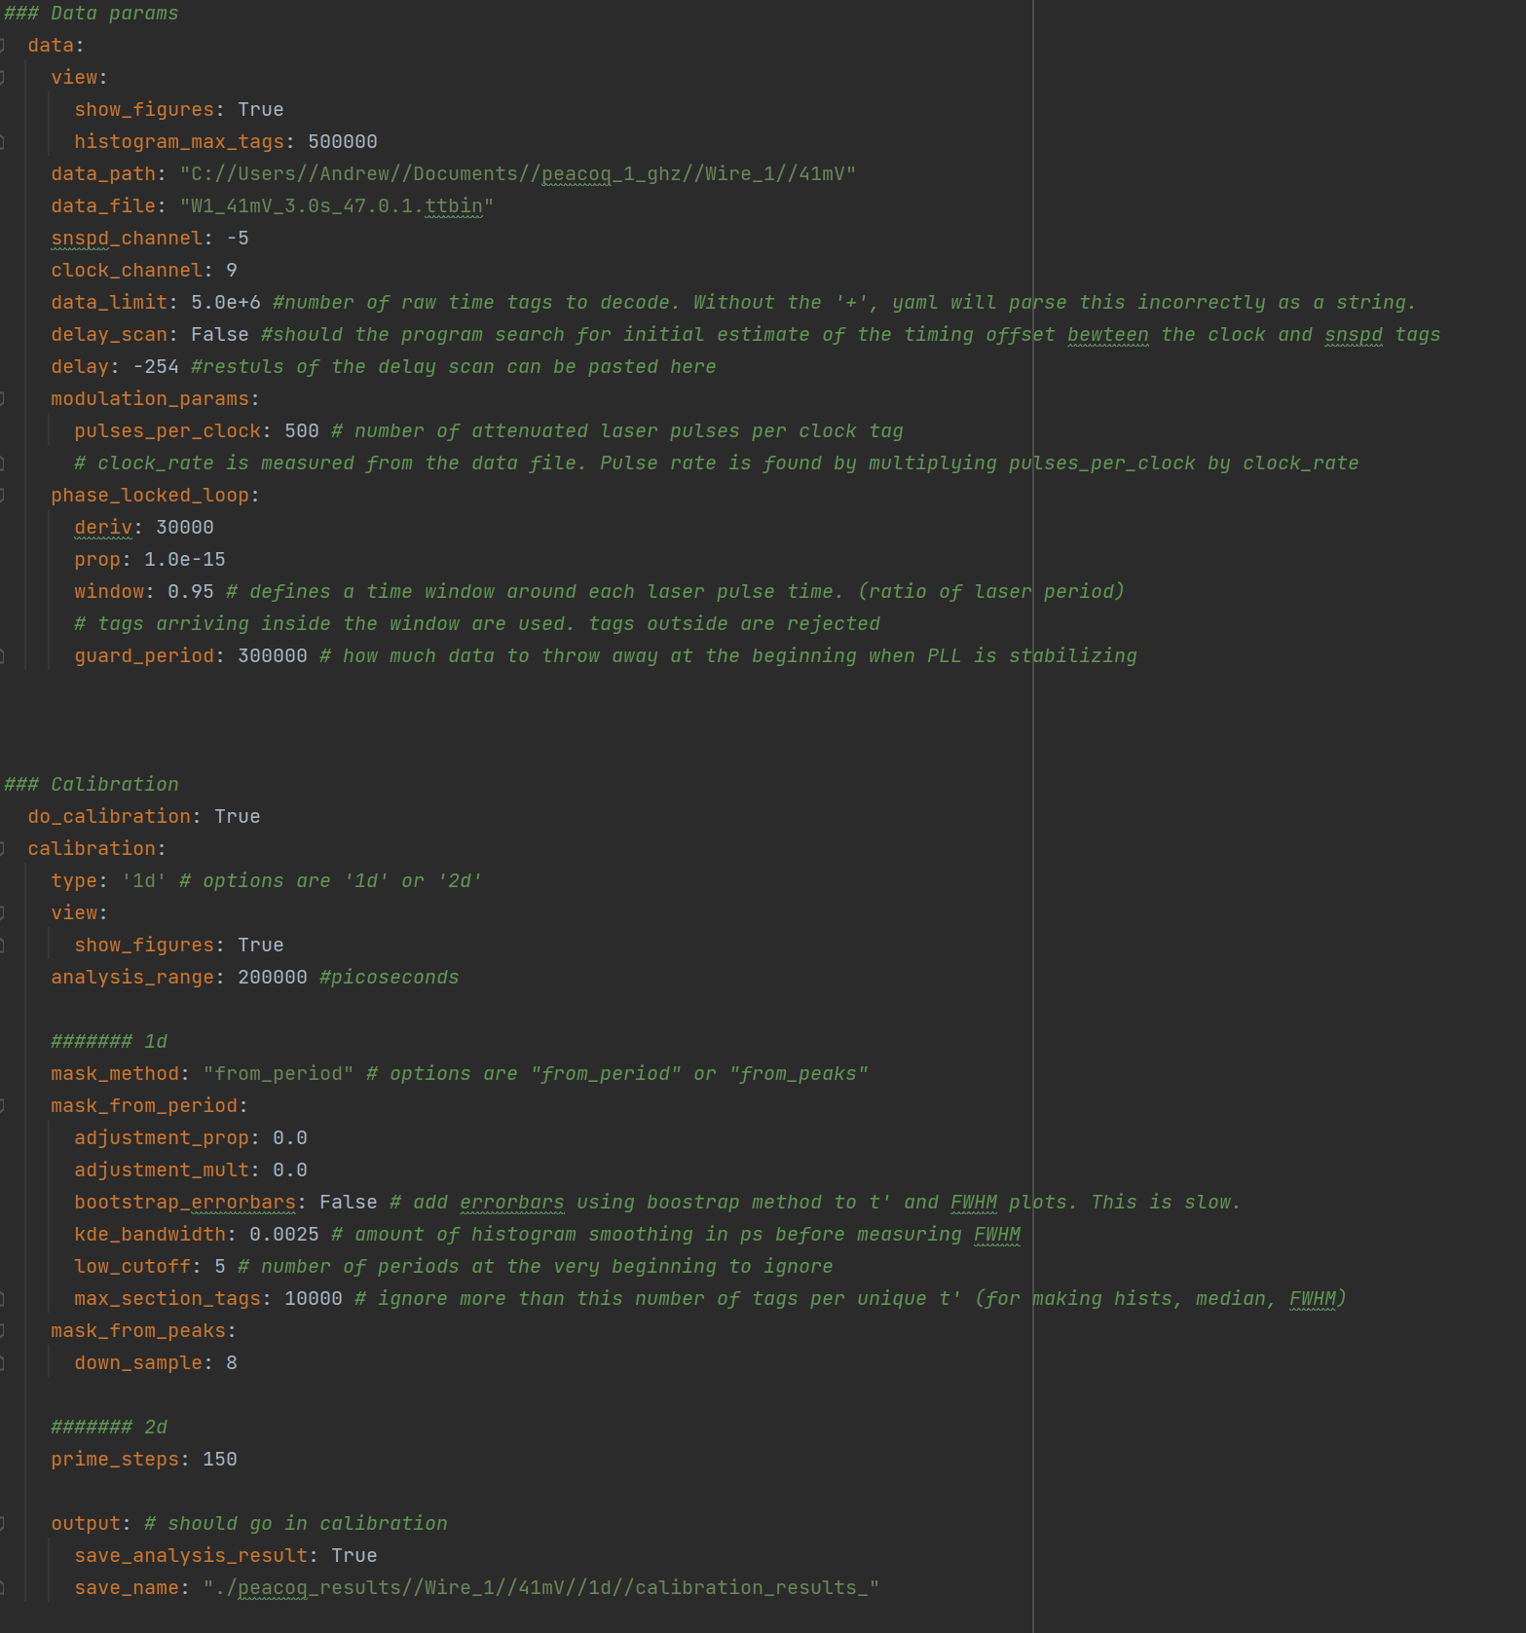
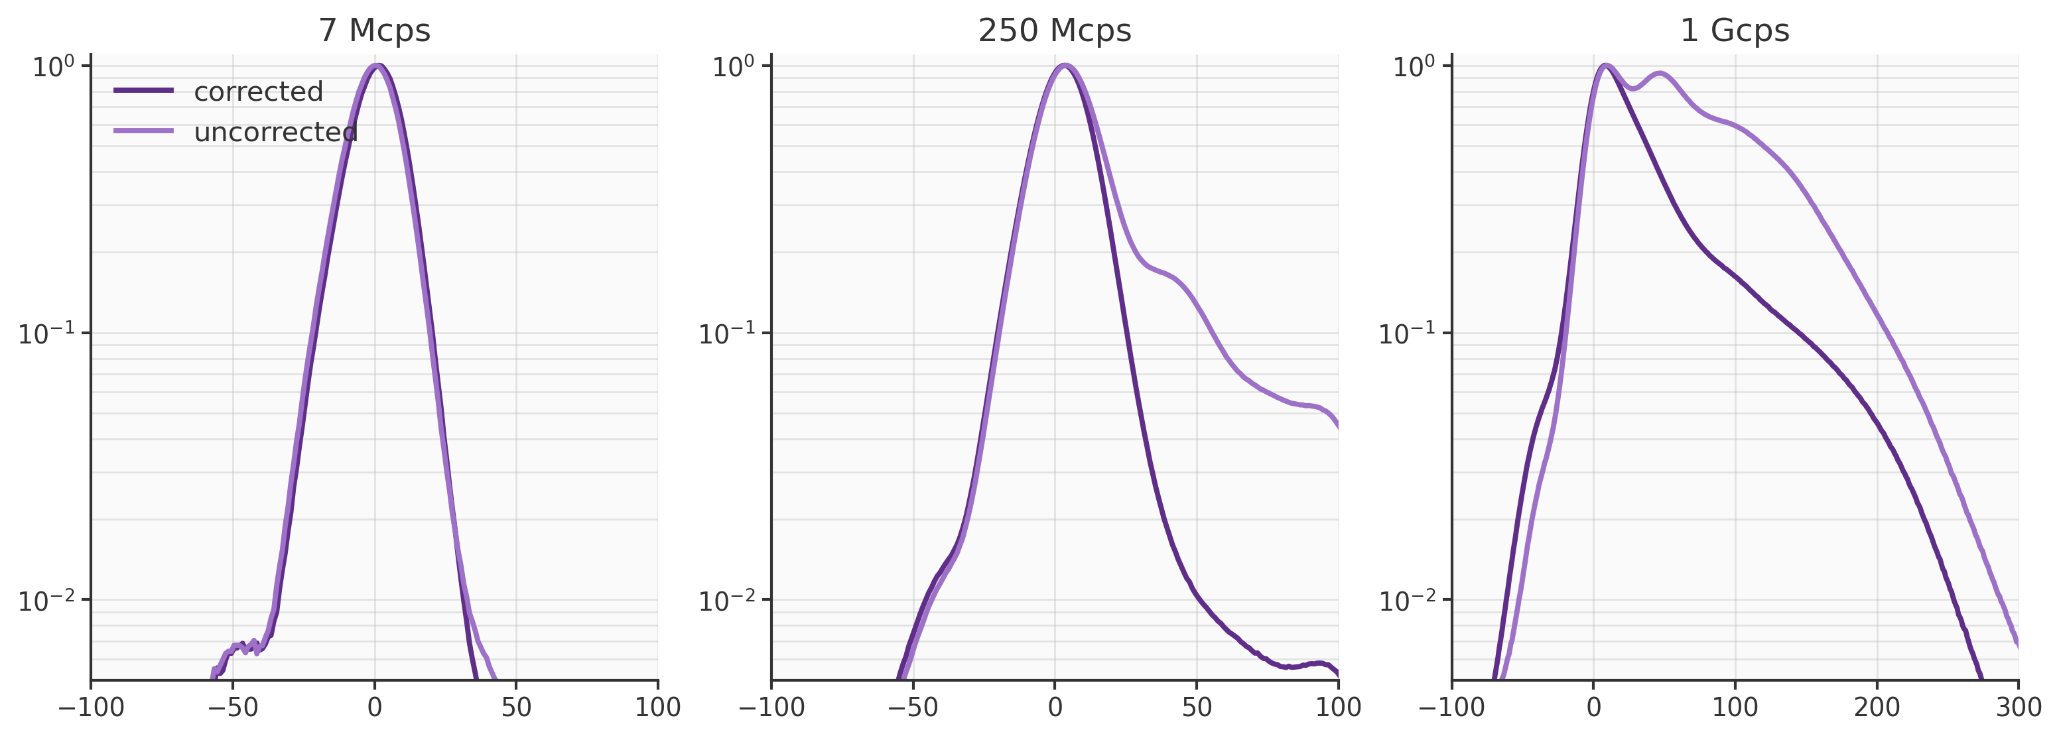
Last Several Weeks
Codebase
More organized and generalized
Array simulations
Last couple days
2nd order corrections!

Slide 4
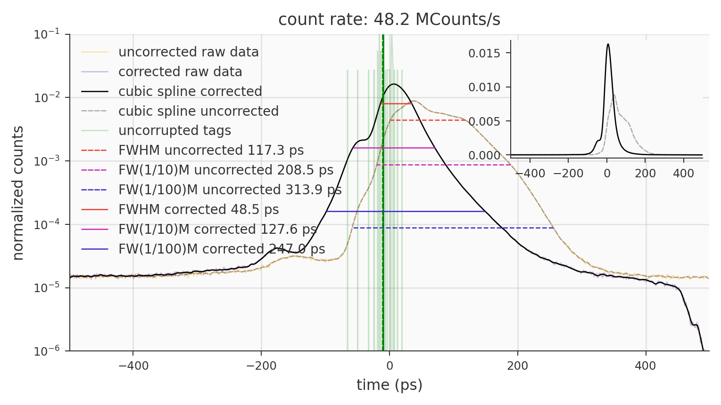
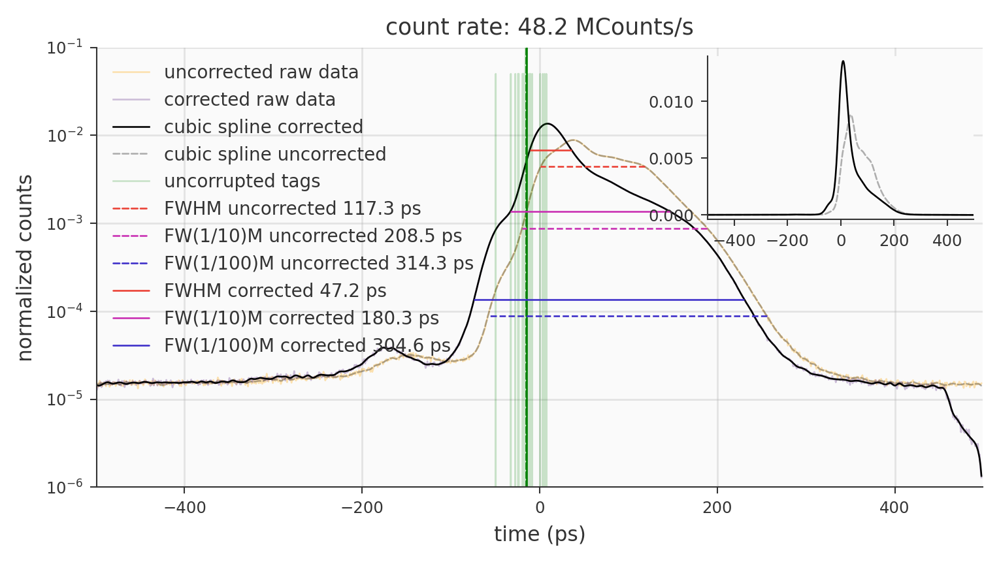
2nd order correction
Fundamentally working, need to test more files and do the array simulation
Shouldn’t take that long, as the code is much more organized

Slide 5
2nd order correction

